Slide 1



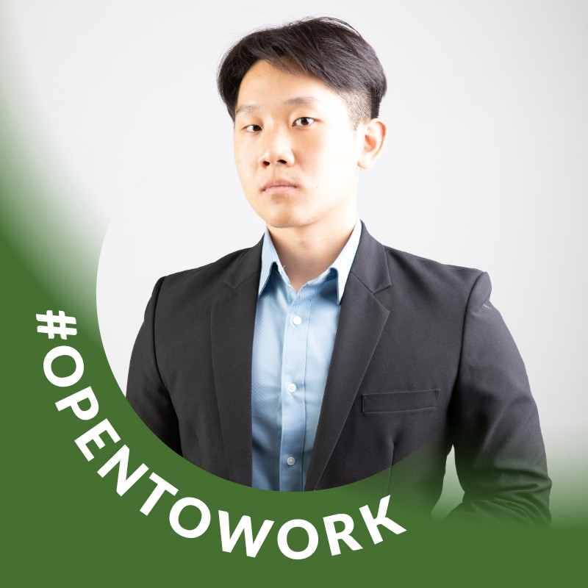
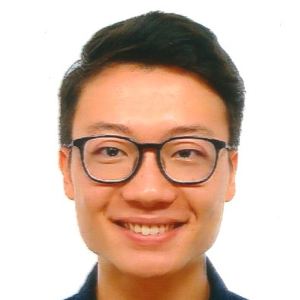
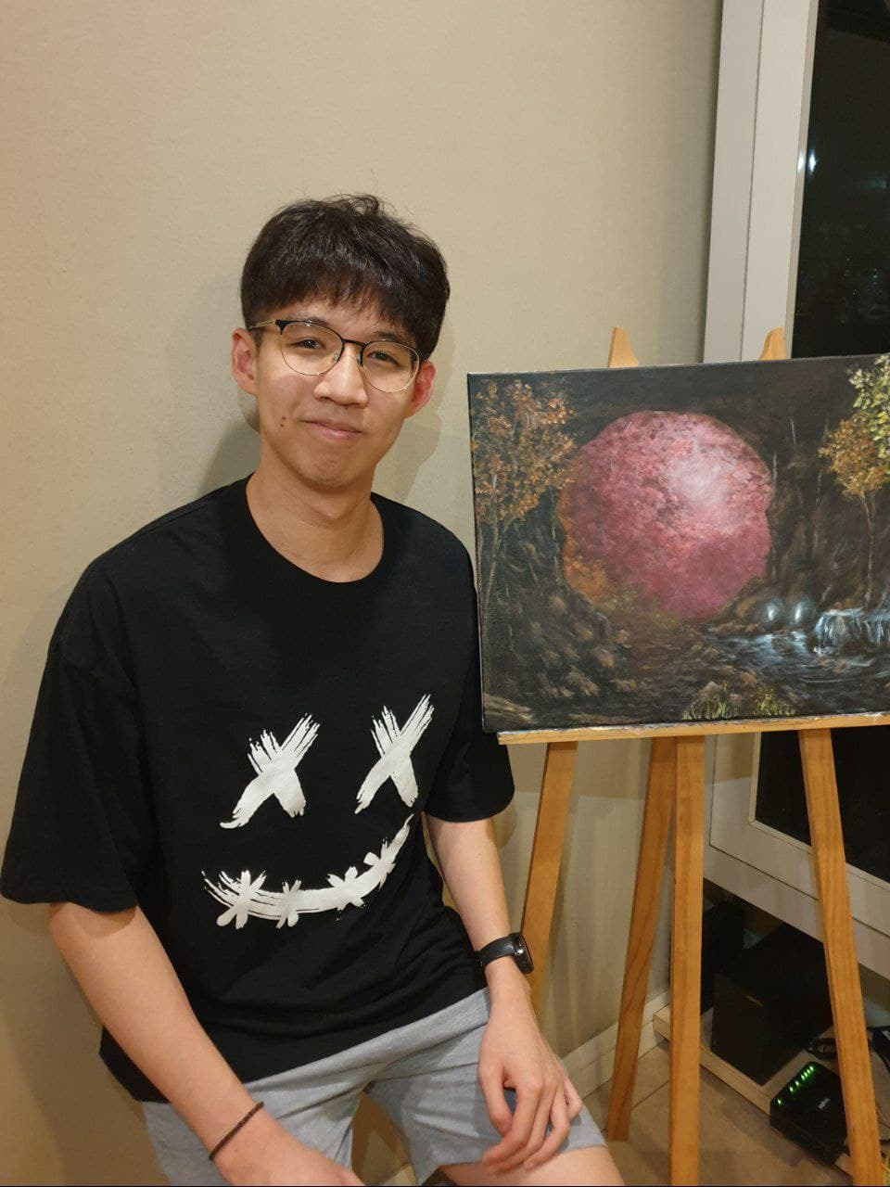
CS4243 project
Image inpainting on Frogs dataset
Introduction
Dataset
Experiments & analysis
Conclusions
Naaman Tan
Chetwin Low
Chen Yuan Bo

Slide 2


1. Introduction
Image inpainting

Slide 3
What is image inpainting?

Slide 4
What is image inpainting?
Intuitively, filling in gaps in images

Slide 5
What is image inpainting?
Intuitively, filling in gaps in images
Mathematically, mapping at the level of sets
Given an image x, which can be mapped to any plausible image y
f : x → Y

Slide 6
What is image inpainting?
Intuitively, filling in gaps in images
Mathematically, mapping at the level of sets
Given an image x, which can be mapped to any plausible image y
f : x → Y
Non-trivial
Any image x can map to Y
Also, multiple images x can map to same y

Slide 7
What is image inpainting?
Intuitively, filling in gaps in images
Mathematically, mapping at the level of sets
Given an image x, which can be mapped to any plausible image y
f : x → Y
Non-trivial
Any image x can map to Y
Also, multiple images x can map to same y
Applications in photo editing, digital art, image restoration

Slide 8
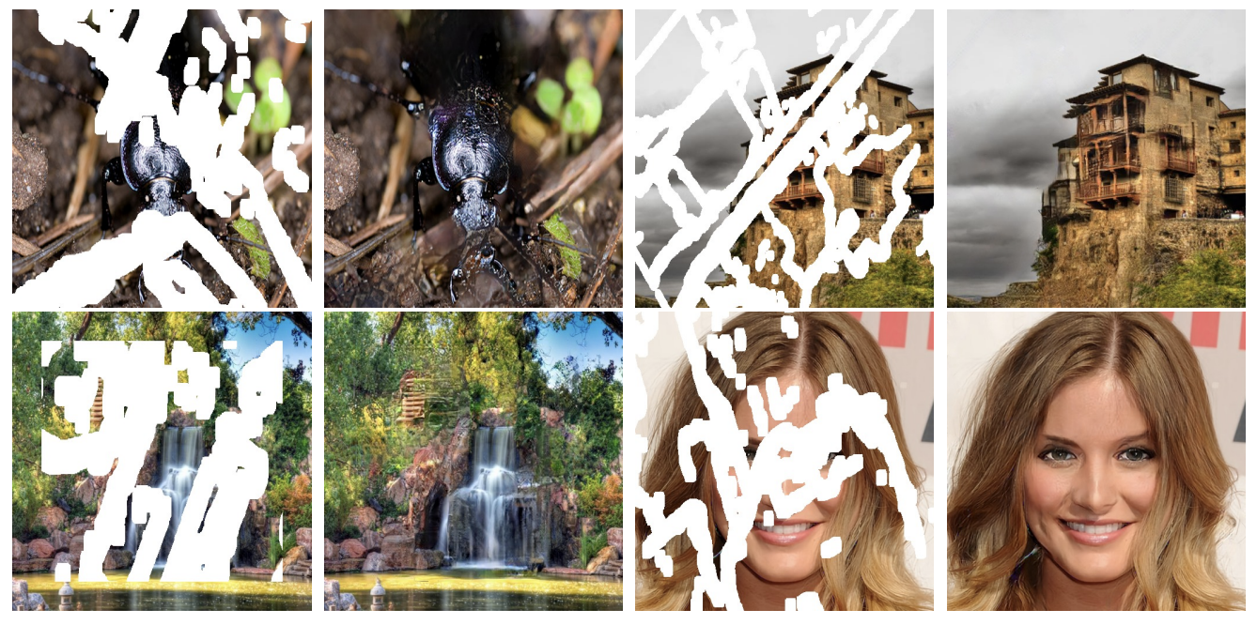

Slide 9
2. Dataset
Frogs!

Slide 10

Dataset construction
iNaturalist is a crowdsourced species identification system
91 million observations, 344k species

Slide 11
Dataset construction
iNaturalist is a crowdsourced species identification system
91 million observations, 344k species
> We pull all frog images from the last 2 years as our training dataset.

Slide 12
Dataset construction
iNaturalist is a crowdsourced species identification system
91 million observations, 344k species
> We pull all frog images from the last 2 years as our training dataset.
> To clean the dataset, we:

Slide 13
Dataset construction
iNaturalist is a crowdsourced species identification system
91 million observations, 344k species
> We pull all frog images from the last 2 years as our training dataset.
> To clean the dataset, we:
Identify & remove noisy samples with description labels

Slide 14
Dataset construction
iNaturalist is a crowdsourced species identification system
91 million observations, 344k species
> We pull all frog images from the last 2 years as our training dataset.
> To clean the dataset, we:
Identify & remove noisy samples with description labels
Identify & remove under-represented classes

Slide 15
Dataset construction
iNaturalist is a crowdsourced species identification system
91 million observations, 344k species
> We pull all frog images from the last 2 years as our training dataset.
> To clean the dataset, we:
Identify & remove noisy samples with description labels
Identify & remove under-represented classes
Resize images to 64 x 64

Slide 16
Dataset construction
iNaturalist is a crowdsourced species identification system
91 million observations, 344k species
> We pull all frog images from the last 2 years as our training dataset.
Identify & remove noisy samples with description labels
Identify & remove under-represented classes
Resize images to 64 x 64
Dynamically mask with random-sized/positioned rectangles

Slide 17
Dataset construction
iNaturalist is a crowdsourced species identification system
91 million observations, 344k species
> We pull all frog images from the last 2 years as our training dataset.
Identify & remove noisy samples with description labels
Identify & remove under-represented classes
Resize images to 64 x 64
Dynamically mask with random-sized/positioned rectangles
> Left with 10k train, 1k validation, 517 test

Slide 18
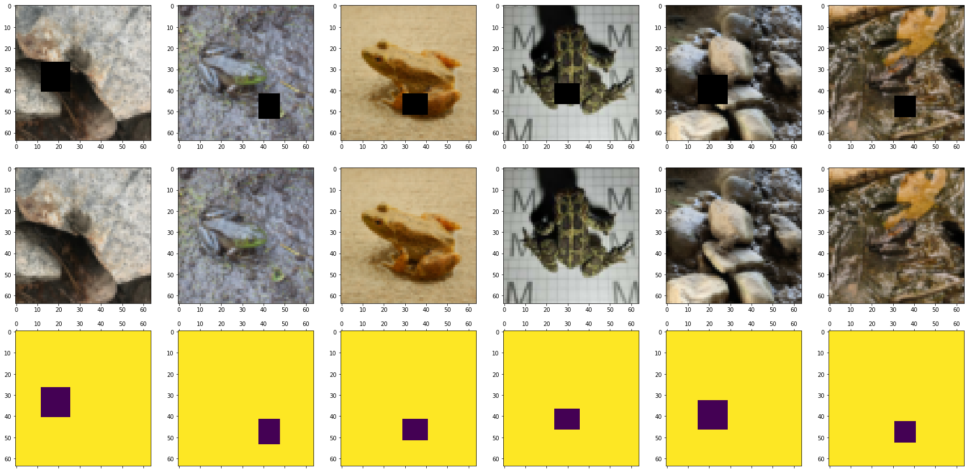
Sample images

Slide 19
3. Experiments
From baselines to GANs

Slide 20
Baseline models

Slide 21
Baseline models
Image inpainting is a conditional image generation task, where output distribution is conditioned on valid pixels [1]

Slide 22
Baseline models
Image inpainting is a conditional image generation task, where output distribution is conditioned on valid pixels [1]
Main families of model architectures [1]:

Slide 23
Baseline models
Image inpainting is a conditional image generation task, where output distribution is conditioned on valid pixels [1]
Main families of model architectures [1]:
Autoregressive models
Autoencoders
Variational Autoencoders
Generative Adversarial networks

Slide 24
Baseline models
Image inpainting is a conditional image generation task, where output distribution is conditioned on valid pixels [1]
Main families of model architectures [1]:
Autoregressive models
Autoencoders
Variational Autoencoders
Generative Adversarial networks
> For simplicity, we implement autoencoders and GAN’s as baselines

Slide 25
Baseline models
Image inpainting is a conditional image generation task, where output distribution is conditioned on valid pixels [1]
Main families of model architectures [1]:
Autoregressive models
Autoencoders
Variational Autoencoders
Generative Adversarial networks
> For simplicity, we implement autoencoders and GAN’s as baselines
> We also implement CNN’s an MLP’s as fundamental baselines

Slide 26
Baselines: MLP & CNN

Slide 27
Baselines: MLP & CNN
MLP architecture
3 layers of fully-connected layers
64 channels
Mish activation function [2]
MSE loss applied to masked region

Slide 28
Baselines: MLP & CNN
MLP architecture
3 layers of fully-connected layers
64 channels
Mish activation function [2]
MSE loss applied to masked region
CNN architecture
17 layers of same-size convolutions, with residual skips [3]
64 channels
Mish activation function
MSE loss applied to masked region

Slide 29
Baselines: Autoencoders and GANs
Autoencoder architecture
17 layers, downsampled (halved) twice, upsampled twice
64 channels
Mish activation function
L2 loss applied to masked region

Slide 30
Baselines: Autoencoders and GANs
Autoencoder architecture
17 layers, downsampled (halved) twice, upsampled twice
64 channels
Mish activation function
MSE loss applied to masked region
GAN architecture
Generator
same as autoencoder
Discriminator
5 layers, halving every time, linear classifier at end
64 channels
BCE loss

Slide 31
Baselines: Autoencoders and GANs
Autoencoder/generator architecture
17 layers
64 channels
Mish activation function [*]
MSE loss applied to masked region
Discriminator architecture
17 layers of same-size convolutions, with residual skips [*]
64 channels
Mish activation function [*]
MSE loss applied to masked region
2. 8 x same
1. Same-> down -> same -> down
3. up -> same -> up -> same
1. 5 x down
2. Reshape & classify

Slide 32
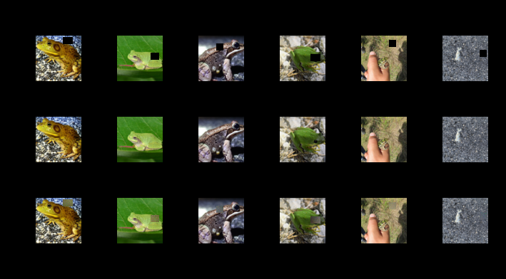
Results: MLP (dynamic mask)
IN
GT
General noise reconstructed
OUT

Slide 33
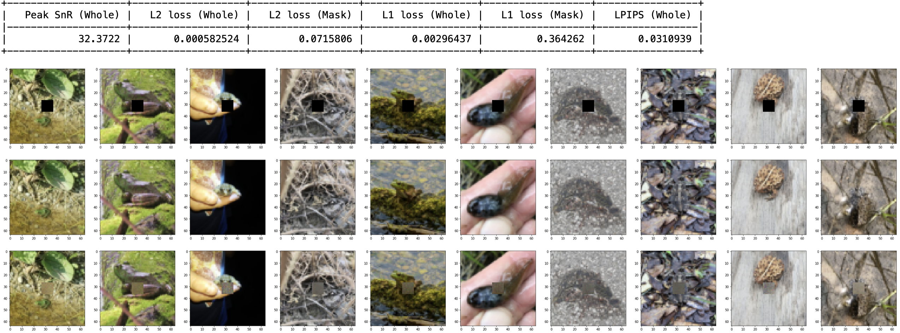
Results: MLP (center mask)
IN
GT
General noise reconstructed
OUT

Slide 34
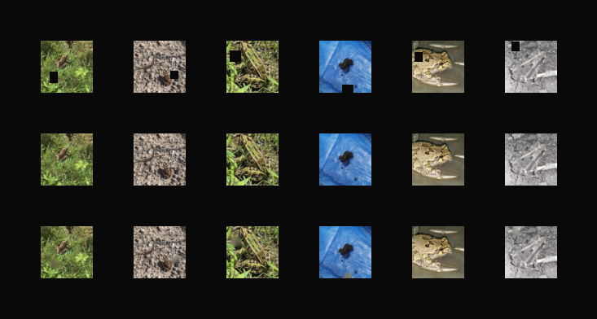
Results: CNN (dynamic mask)
IN
GT
Notice the general blurriness and grey hue
OUT

Slide 35
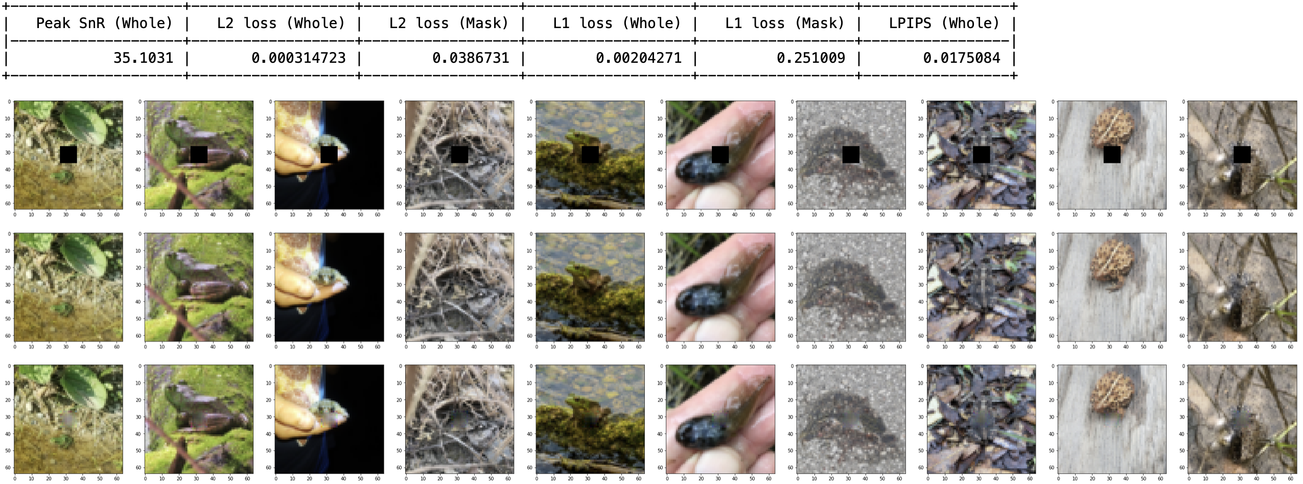
Results: CNN (center mask)

Slide 36
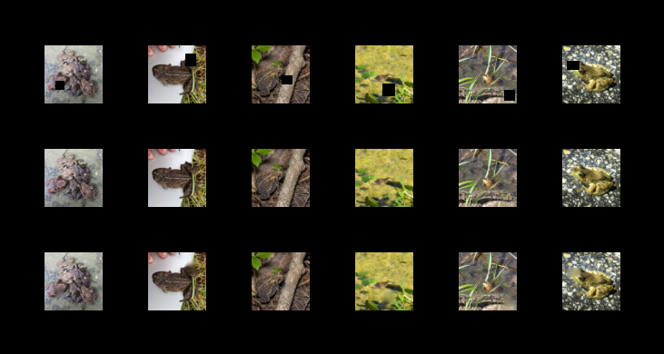
Results: Autoencoder (dynamic mask)
IN
GT
Colours are better! But very “smooth”, not much texture
OUT

Slide 37
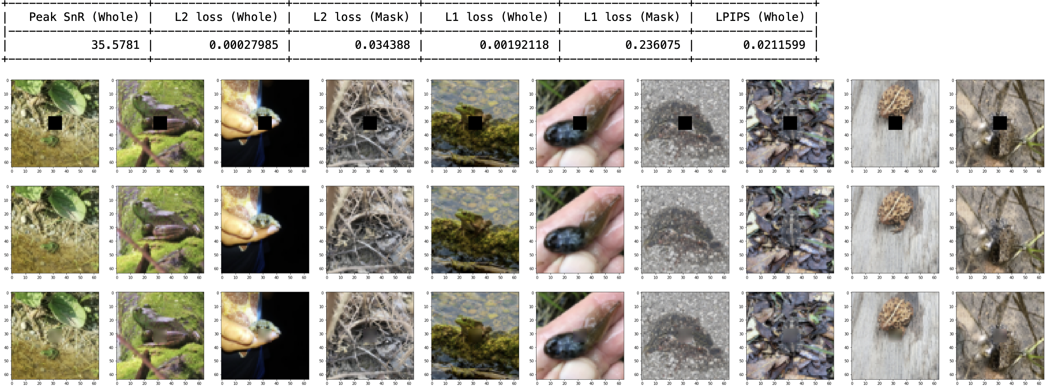
Results: Autoencoder (center mask)

Slide 38
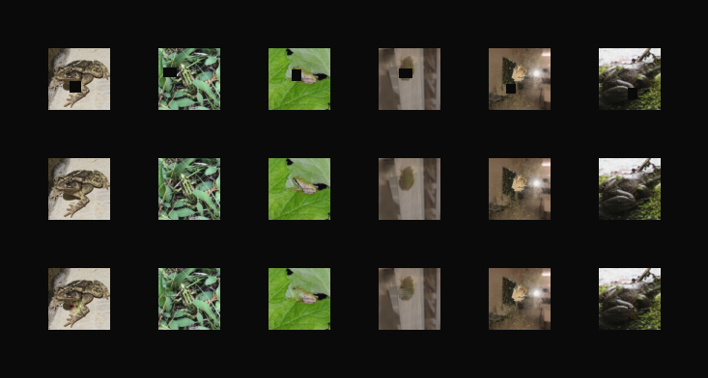
Results: GAN
IN
GT
Textures/boundaries generally present, colours pretty good too!
OUT

Slide 39

Results: GAN (center mask)

Slide 40
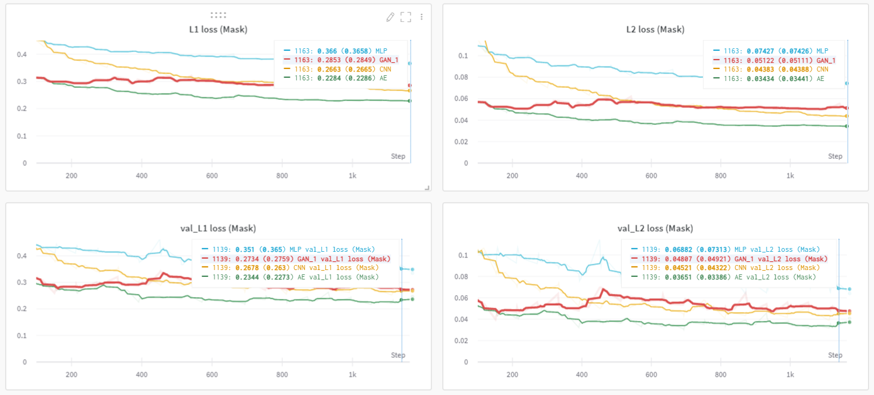
Training curves

Slide 41
Reviewing our baselines
Metric/model | MLP | CNN | Autoencoder | GAN
L1 | 0.3642 | 0.2510 | 0.2361 | 0.2750
MSE | 0.07158 | 0.03867 | 0.03439 | 0.04460
LPIPS | 0.03109 | 0.01882 | 0.02116 | 0.01750
PSnR | 32.37 | 35.10 | 35.58 | 34.43

Slide 42
Key observations
MLP < CNN < Autoencoder < GAN

Slide 43
Key observations
MLP < CNN < Autoencoder < GAN
Qualitatively, GAN images look best

Slide 44
Key observations
MLP < CNN < Autoencoder < GAN
Qualitatively, GAN images look best
But most reconstruction metrics of Autoencoder are best

Slide 45
Key observations
MLP < CNN < Autoencoder < GAN
Qualitatively, GAN images look best
But most reconstruction metrics of Autoencoder are best
> Why?

Slide 46
Key observations
MLP < CNN < Autoencoder < GAN
Qualitatively, GAN images look best
But most reconstruction metrics of Autoencoder are best
> Why?
Metrics used (L1 loss, L2 loss, PSnR) all favour blurry and smooth images without much texture [4]
GAN model leads in perceptual similarity by VGG, supporting this view

Slide 47
More observations

Slide 48
More observations
GAN’s are notorious for unstable training, as they require generator and discriminator to be in a Nash equilibrium [5]

Slide 49
More observations
GAN’s are notorious for unstable training, as they require generator and discriminator to be in a Nash equilibrium [5]
Issues like mode collapse [6] can be faced

Slide 50
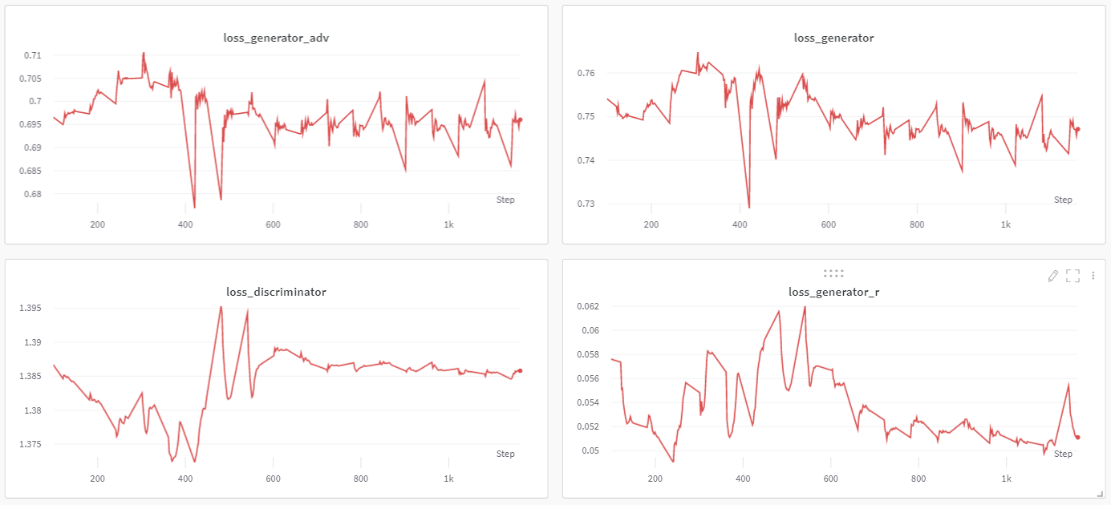
More observations
GAN’s are notorious for unstable training, as they require generator and discriminator to be in a Nash equilibrium [5]
Issues like mode collapse [6] can be faced
> In our experiments, we also observe high instability

Slide 51
More observations
GAN’s are notorious for unstable training, as they require generator and discriminator to be in a Nash equilibrium [5]
Issues like mode collapse [6] can be faced
> In our experiments, we also observe high instability
> We can investigate the weighting of adversarial loss
> Weighting term, alpha = 1, 0.1, 0.01, 0.001

Slide 52
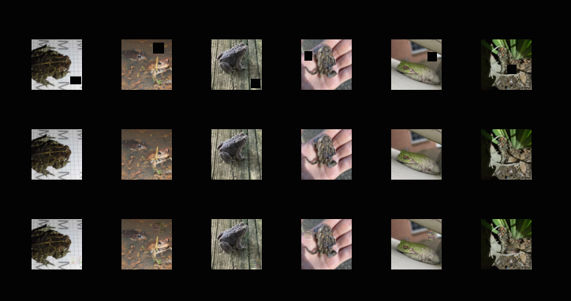
Results: GAN@alpha=1
IN
GT
OUT

Slide 53
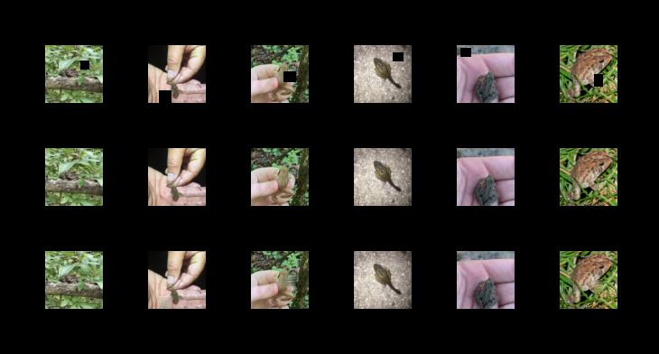
Results: GAN@alpha=0.1
IN
GT
OUT

Slide 54
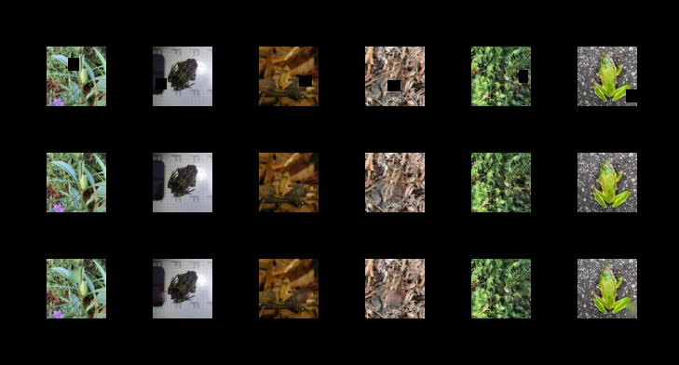
Results: GAN@alpha=0.01
IN
GT
OUT

Slide 55
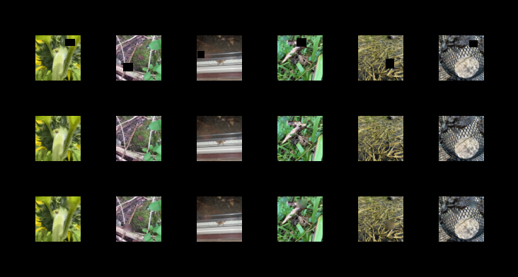
Results: GAN@alpha=0.001
IN
GT
OUT

Slide 56
Results: GAN@alpha=1

Slide 57

Results: GAN@alpha=0.1

Slide 58

Results: GAN@alpha=0.01

Slide 59

Results: GAN@alpha=0.001

Slide 60
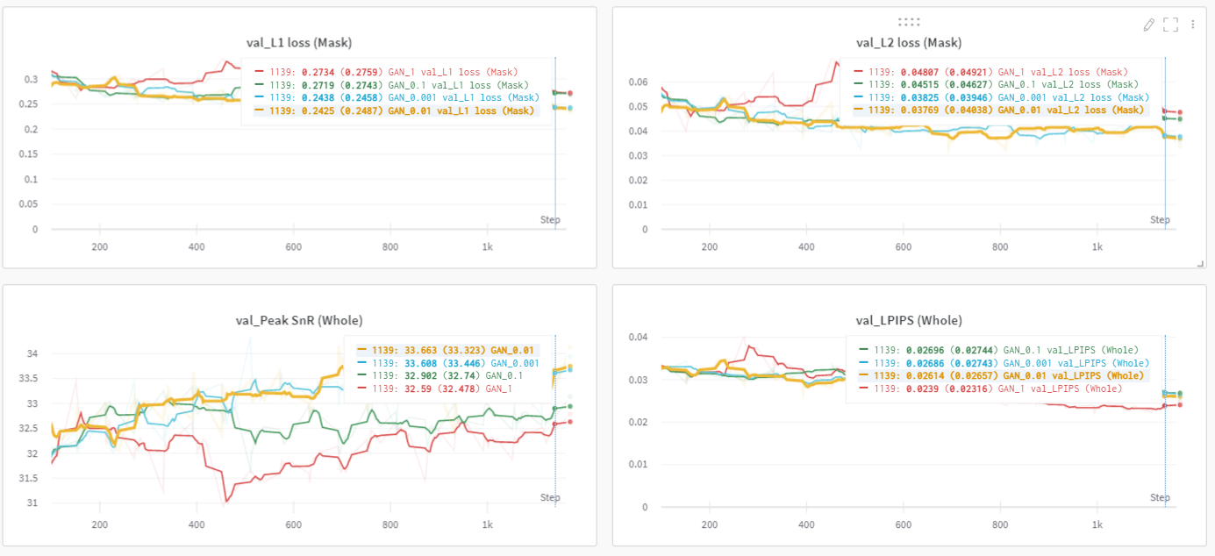
Training curves

Slide 61
Reviewing adversarial loss weight
Metric/model | GAN@1 | GAN@0.1 | GAN@0.01 | GAN@0.001
L1 | 0.2734 | 0.2719 | 0.2425 | 0.2438
MSE | 0.04807 | 0.04515 | 0.03769 | 0.03825
LPIPS | 0.02316 | 0.02696 | 0.02614 | 0.02743
PSnR | 32.59 | 32.902 | 33.663 | 33.608
> Alpha = 1 has best perceptual similarity, so we use that
> How to improve further? Look at techniques in literature!

Slide 62
Techniques in literature

Slide 63
Techniques in literature
To create a semantically plausible and realistic image, a model needs:

Slide 64
Techniques in literature
To create a semantically plausible and realistic image, a model needs:
To encode global, semantic structure

Slide 65
Techniques in literature
To create a semantically plausible and realistic image, a model needs:
To encode global, semantic structure
To produce details/textures consistent with pixels around the holes

Slide 66
Techniques in literature
To create a semantically plausible and realistic image, a model needs:
To encode global, semantic structure
To produce details/textures consistent with pixels around the holes
Techniques producing SOTA results are:
Increase receptive field by dilated convolutions [7]
Local & global discriminators [7]
Partial/gated convolutions [8,9]
Patch-based discriminators [10]

Slide 67
Techniques in literature
To create a semantically plausible and realistic image, a model needs:
To encode global, semantic structure
To produce details/textures consistent with pixels around the holes
Techniques producing SOTA results are:
Increase receptive field by dilated convolutions [7]
Local & global discriminators [7]
Partial/gated convolutions [8,9]
Patch-based discriminators [10]
> We individually implement smaller examples of these models

Slide 68
Experiment #1: Gated/dilated convolutions

Slide 69
Experiment #1: Gated/dilated convolutions
Main idea #1: dilated convolutions
Initially proposed by Iizuka et al. [7]
Dilated convolutions provide a cheap way of increasing receptive field size for each inpainted pixel

Slide 70
Experiment #1: Gated/dilated convolutions
Main idea #1: dilated convolutions
Initially proposed by Iizuka et al. [7]
Dilated convolutions provide a cheap way of increasing receptive field size for each inpainted pixel
Main idea #2: gated convolutions
Non-learnable version first by [8], then later improved by [9]
Learnable gating
Invalid masked pixels do not propagate their values forward

Slide 71
Experiment #1: Gated/dilated convolutions
Generator architecture
Same as baseline GAN, with small changes
4 middle layers with dilated convolutions
All layers with gated convolutions

Slide 72
Experiment #1: Gated/dilated convolutions
Generator architecture
Same as baseline GAN, with small changes
4 middle layers with dilated convolutions
All layers with gated convolutions
Discriminator architecture
Same as baseline GAN

Slide 73
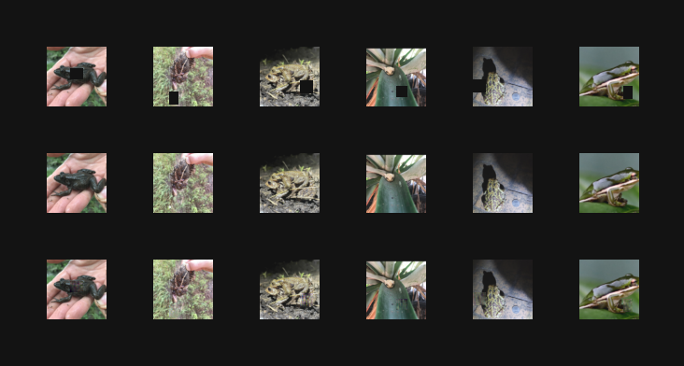
Results: DilatedGatedGAN@alpha=1
IN
GT
Some reconstructions are very plausible, less greyish hue, more colours from image (probably due to gated convolutions)
OUT

Slide 74
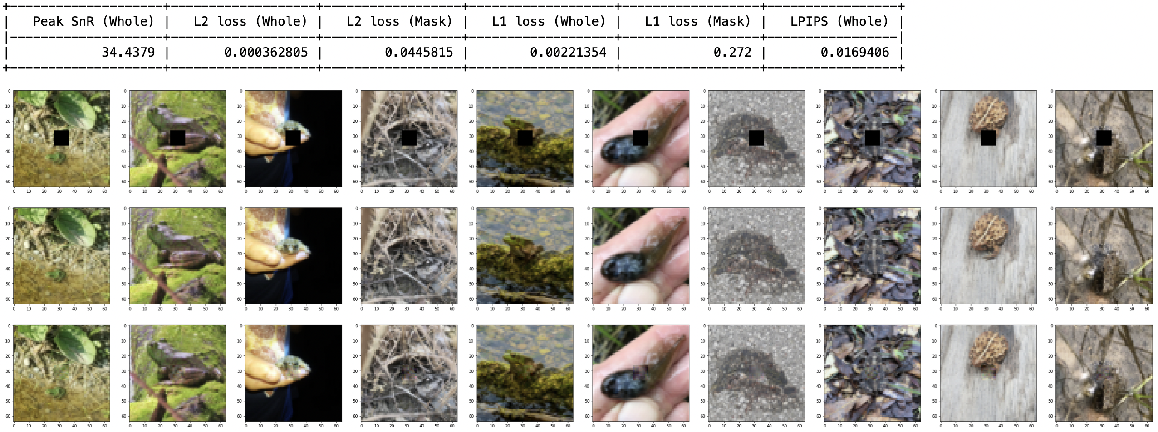
Results: DilatedGatedGAN@alpha=1

Slide 75
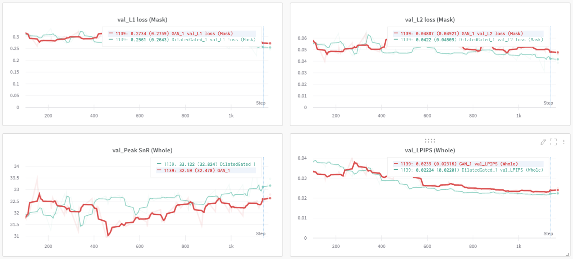
Training curves

Slide 76
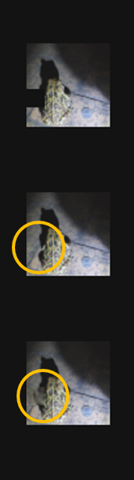
Insights #1: Gated/dilated convolutions

Slide 77
Insights #1: Gated/dilated convolutions
Generated images have richer textures
Better colour coherence with surrounding image
Qualitatively and quantitatively beats baseline GAN model

Slide 78
Insights #1: Gated/dilated convolutions
Generated images have richer textures
Better colour coherence with surrounding image
Qualitatively and quantitatively beats baseline GAN model
> But in some samples, locally looks good, but globally strange
> Especially pronounced when cutting across lines

Slide 79
Insights #1: Gated/dilated convolutions
Generated images have richer textures
Better colour coherence with surrounding image
Qualitatively and quantitatively beats baseline GAN model
> But in some samples, locally looks good, but globally strange
> Especially pronounced when cutting across lines
> Idea: use global & local features separately to discriminate!

Slide 80
Experiment #2: local & global discrimination

Slide 81
Experiment #2: local & global discrimination
Following idea proposed by Iizuka et al. [7]
Discriminator takes in two inputs – masked patch, and whole image
Hidden vectors generated in parallel, then concatenated before classification by a linear layer

Slide 82
Experiment #2: local & global discrimination
Generator architecture:
Same as experiment #1
Discriminator architecture:
Same as experiment #1, but basically duplicated
One arm to classify based on masked & resized (to 16x16) image, one arm based on whole image
Context vectors concatenated before classification

Slide 83
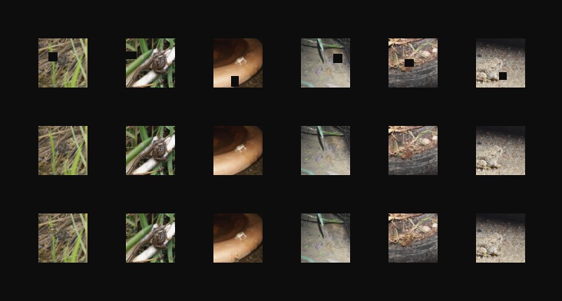
Results: LocalGlobalGAN@alpha=1
IN
GT
Very good reconstructions! But still some discontinuities at lines.
OUT

Slide 84

Results: LocalGlobalGAN@alpha=1

Slide 85
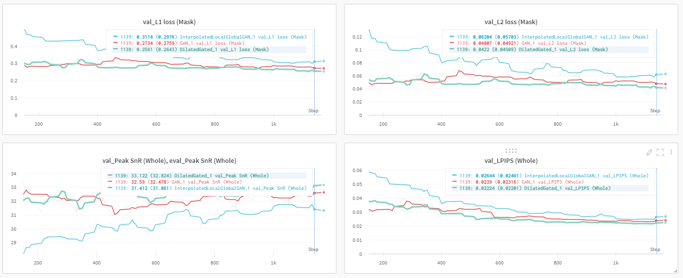
Training curves

Slide 86
Insights #2: local & global discrimination

Slide 87
Insights #2: local & global discrimination
Generated images have better consistency (especially relating to color)

Slide 88
Insights #2: local & global discrimination
Generated images have better consistency (especially relating to color)
Quantitatively comparable to previous two models, but slightly worse

Slide 89
Insights #2: local & global discrimination
Generated images have better consistency (especially relating to color)
Quantitatively comparable to previous two models, but slightly worse
> Larger model, likely underfitting after just 20 epochs

Slide 90
Insights #2: local & global discrimination
Generated images have better consistency (especially relating to color)
Quantitatively comparable to previous two models, but slightly worse
> Larger model, likely underfitting after just 20 epochs
> Idea: merge “global” and “local” discriminator into single pixelwise discriminator

Slide 91
Experiment #3: patch discrimination
Main idea drawn from PatchGAN [10, 11], where discriminator outputs a segmentation map of “real” vs. “fake” pixels

Slide 92
Experiment #3: patch discrimination
Main idea drawn from PatchGAN [10, 11], where discriminator outputs a segmentation map of “real” vs. “fake” pixels
Adversarial loss is more detailed as result

Slide 93
Experiment #3: patch discrimination
Main idea drawn from PatchGAN [10, 11], where discriminator outputs a segmentation map of “real” vs. “fake” pixels
Adversarial loss is more detailed as result
Generator architecture:
Same as experiment #1

Slide 94
Experiment #3: patch discrimination
Main idea drawn from PatchGAN [10, 11], where discriminator outputs a segmentation map of “real” vs. “fake” pixels
Adversarial loss is more detailed as result
Generator architecture:
Same as experiment #1
Discriminator architecture:
Same as experiment #1, but output is a binary segmentation map, rather than binary classification

Slide 95
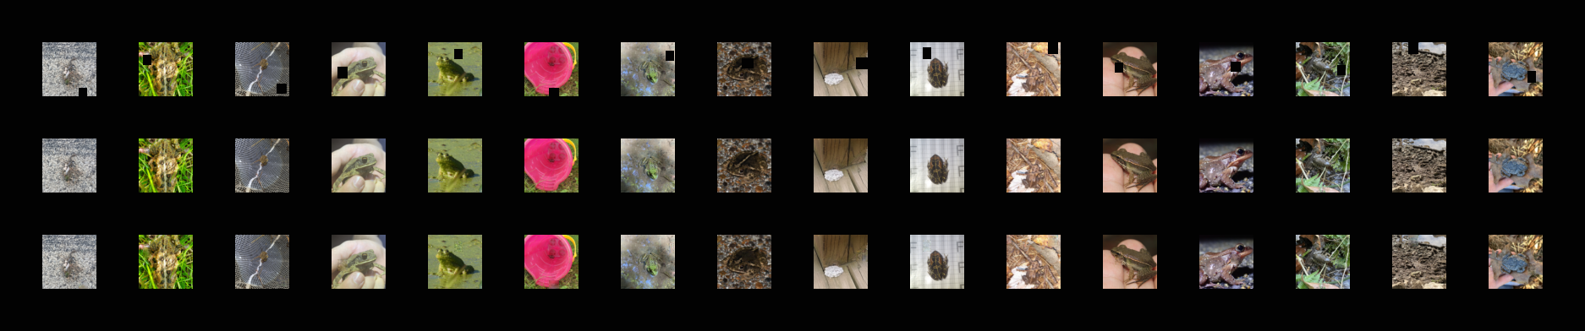
Results: PatchGAN@alpha=1
IN
GT
Very good reconstructions! But still some discontinuities at lines.
OUT

Slide 96
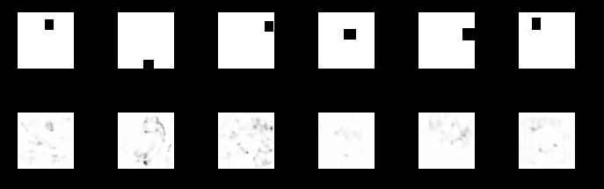
Results: PatchGAN@alpha=1
MASK
Discriminator prediction
OUT

Slide 97

Results: PatchGAN@alpha=1

Slide 98
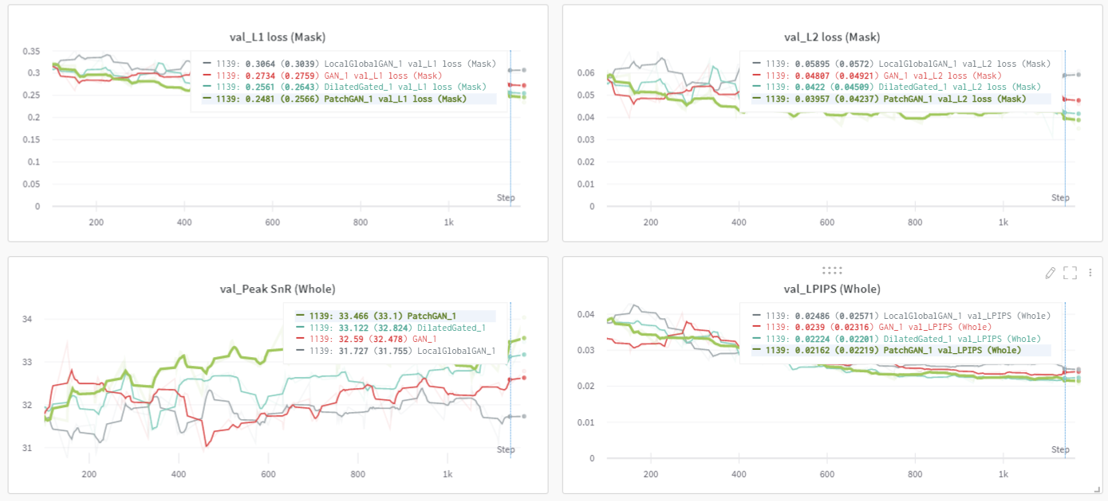
Training curves

Slide 99
Insights #3: patch discrimination
Qualitatively and quantitatively the best model so far

Slide 100
Insights #3: patch discrimination
Qualitatively and quantitatively the best model so far
Generated images are good, even on challenging scenes involving a lot of lines and colours

Slide 101
Insights #3: patch discrimination
Qualitatively and quantitatively the best model so far
Generated images are good, even on challenging scenes involving a lot of lines and colours
> How can we improve things on the generator’s side?

Slide 102
Insights #3: patch discrimination
Qualitatively and quantitatively the best model so far
Generated images are good, even on challenging scenes involving a lot of lines and colours
> How can we improve things on the generator’s side?
> Idea: Simplify the task

Slide 103
Insights #3: patch discrimination
Qualitatively and quantitatively the best model so far
Generated images are good, even on challenging scenes involving a lot of lines and colours
> How can we improve things on the generator’s side?
> Idea: Simplify the task
> get model to first predict texture, then use that to predict colour!

Slide 104
Experiment #4: edge-first generation

Slide 105
Experiment #4: edge-first generation
Main idea:

Slide 106
Experiment #4: edge-first generation
Main idea:
Model first predicts structure of image (gray-scale).

Slide 107
Experiment #4: edge-first generation
Main idea:
Model first predicts structure of image (gray-scale).
Initial prediction then concatenated to original input, and passed into second model for final prediction

Slide 108
Experiment #4: edge-first generation
Main idea:
Model first predicts structure of image (gray-scale).
Initial prediction then concatenated to original input, and passed into second model for final prediction
Architecture Similar to coarse-to-fine networks for inpainting [12]

Slide 109
Experiment #4: edge-first generation
Main idea:
Model first predicts structure of image (gray-scale).
Initial prediction then concatenated to original input, and passed into second model for final prediction
Architecture Similar to coarse-to-fine networks for inpainting [12]
Based on Multi-task learning [13]

Slide 110
Experiment #4: edge-first generation
Main idea:
Model first predicts structure of image (gray-scale).
Initial prediction then concatenated to original input, and passed into second model for final prediction
Architecture Similar to coarse-to-fine networks for inpainting [12]
Based on Multi-task learning [13]
Generator architecture
Same as experiment #1, except two generators linked together
Discriminator architecture
Same as experiment #1
This way, we can isolate the gains from architectural differences

Slide 111
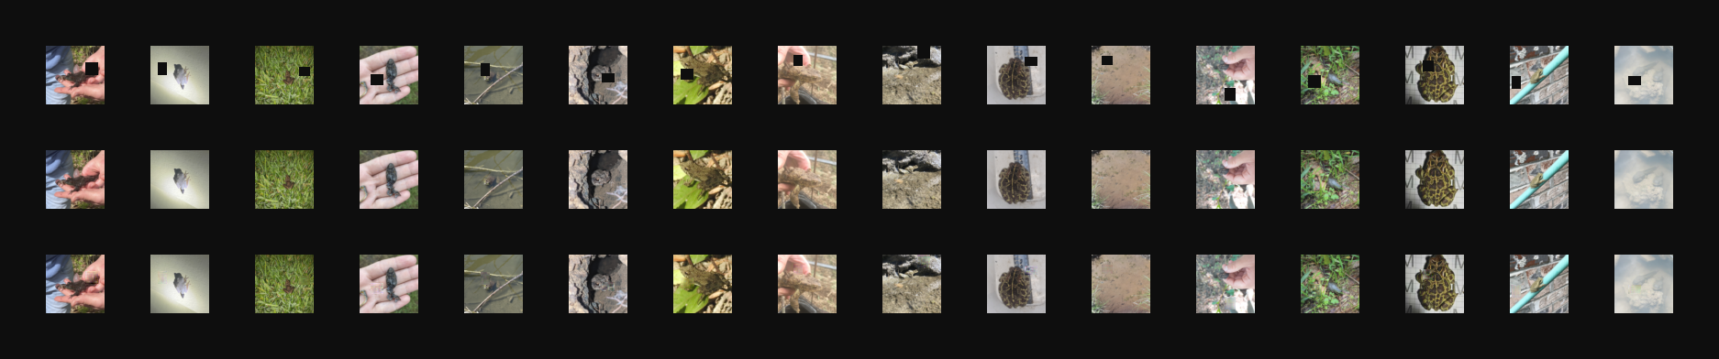
Results: EdgeGAN@alpha=1
IN
GT
Generally good, but sometimes some distorted images
OUT

Slide 112
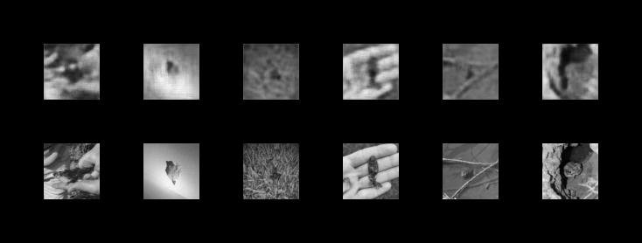
Results: EdgeGAN@alpha=1
PRED
(col)
Gray predictions were generally quite poor!
PRED
(gray)
GT

Slide 113

Results: EdgeGAN@alpha=1

Slide 114
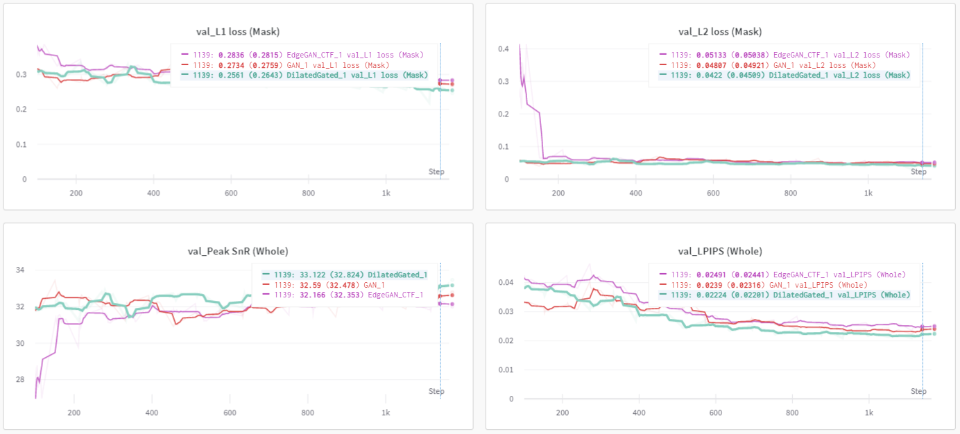
Results: Quantitatively

Slide 115
Insights #4: edge-first generation
Qualitatively and quantitatively worse than the baseline GAN model and the DilatedGatedGAN model

Slide 116
Insights #4: edge-first generation
Qualitatively and quantitatively worse than the baseline GAN model and the DilatedGatedGAN model
> Model had twice as many parameters in generator relative to baseline
> Poorer performance possibly explained by underfitting

Slide 117
Insights #4: edge-first generation
Effectiveness of multi-task learning relies on premises that:

Slide 118
Insights #4: edge-first generation
Effectiveness of multi-task learning relies on premises that:
tasks are sufficiently similar that auxiliary losses guide movement towards minima [13]
(in the case of “stage-wise” MTL, as here is) that output of auxiliary task is itself helpful for main task [13]

Slide 119
Insights #4: edge-first generation
Effectiveness of multi-task learning relies on premises that:
tasks are sufficiently similar that auxiliary losses guide movement towards minima [13]
(in the case of “stage-wise” MTL, as here is) that output of auxiliary task is itself helpful for main task [13]
> Noisy gray image prediction likely affecting generations

Slide 120
Insights #4: edge-first generation
Effectiveness of multi-task learning relies on premises that:
tasks are sufficiently similar that auxiliary losses guide movement towards minima [13]
(in the case of “stage-wise” MTL, as here is) that output of auxiliary task is itself helpful for main task [13]
> Noisy gray image prediction likely affecting generations
> Instead of multi-task, let’s think of it differently – graphs!

Slide 121
Experiment #5: using graphs
Main idea:

Slide 122
Experiment #5: using graphs
Main idea:
Model needs large receptive field to encode global, semantic structure and local texture

Slide 123
Experiment #5: using graphs
Main idea:
Model needs large receptive field to encode global, semantic structure and local texture
Dilated convolutions may not capture fine details or capture non-grid-shaped long-range correlations

Slide 124
Experiment #5: using graphs
Main idea:
Model needs large receptive field to encode global, semantic structure and local texture
Dilated convolutions may not capture fine details or capture non-grid-shaped long-range correlations
We can model the image as a graph, and use graph convolutions to “message pass” global information

Slide 125
Experiment #5: using graphs
Main idea:
Model needs large receptive field to encode global, semantic structure and local texture
Dilated convolutions may not capture fine details or capture non-grid-shaped long-range correlations
We can model the image as a graph, and use graph convolutions to “message pass” global information
Generator architecture
Same as experiment #1, but with graph convolution module
Discriminator architecture
Same as experiment #1

Slide 126
Experiment #5: using graphs
Generator graph convolution module
Dot product of pixel features to generate adjacency tensor
Learnable pruning of adjacency tensor, inspired by [14]
Graph Isomorphism Network [15] convolution for message passing
=> Feature map
-> predict adjacency tensor by dot product
-> prune to get sparse adjacency tensor
-> graph convolutions
-> reshape back to feature map

Slide 127
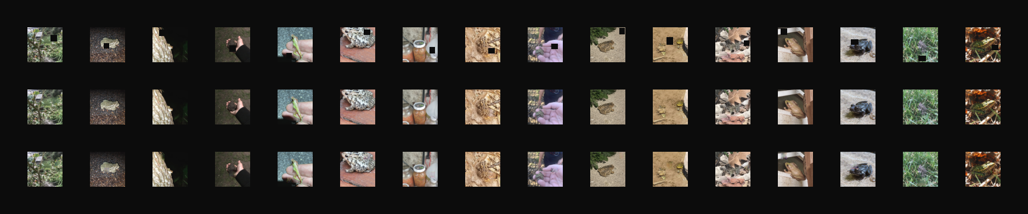
Results: GraphGAN@alpha=1
IN
GT
Textures borrowed from far-regions!
OUT

Slide 128
Results: GraphGAN@alpha=1
IN
Graph can dampen irrelevant positions!
OUT
Number of edges in predicted graph

Slide 129

Results: GraphGAN@alpha=1

Slide 130
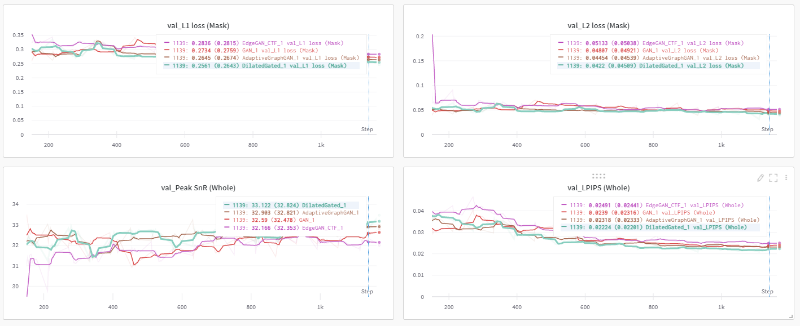
Results: Quantitatively

Slide 131
Insights #5: using graphs
Qualitatively, model performs better for “hard” images with a lot of textures, (especially at corners)
Quantitatively competitive with previous models
> Poorer performance could be due to higher complexity of model – underfit after training for same number of epochs

Slide 132
Experiment #6: contrastive learning
Main idea:

Slide 133
Experiment #6: contrastive learning
Main idea:
Siamese neural networks try to self-regularize by mapping similar images to the same latent space [16]

Slide 134
Experiment #6: contrastive learning
Main idea:
Siamese neural networks try to self-regularize by mapping similar images to the same latent space [16]
Images with different masks should also be mapped to similar latent spaces!

Slide 135
Experiment #6: contrastive learning
Main idea:
Siamese neural networks try to self-regularize by mapping similar images to the same latent space [16]
Images with different masks should also be mapped to similar latent spaces!
Contrastive learning can be applied here as a regularizer

Slide 136
Experiment #6: contrastive learning
Main idea:
Siamese neural networks try to self-regularize by mapping similar images to the same latent space [16]
Images with different masks should also be mapped to similar latent spaces!
Contrastive learning can be applied here as a regularizer
Generator architecture
Same as experiment #1, but paired
Latent vector from each generator used for contrastive L2 loss
Discriminator architecture
Same as experiment #1

Slide 137
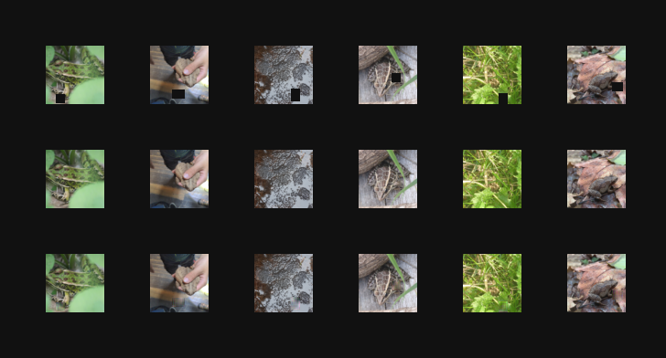
Results: ContrastiveGAN@alpha=1
IN
GT
Generally a little blurry/smooth, without much texture. Sometimes strange colouration.
OUT

Slide 138

Results: ContrastiveGAN@alpha=1

Slide 139
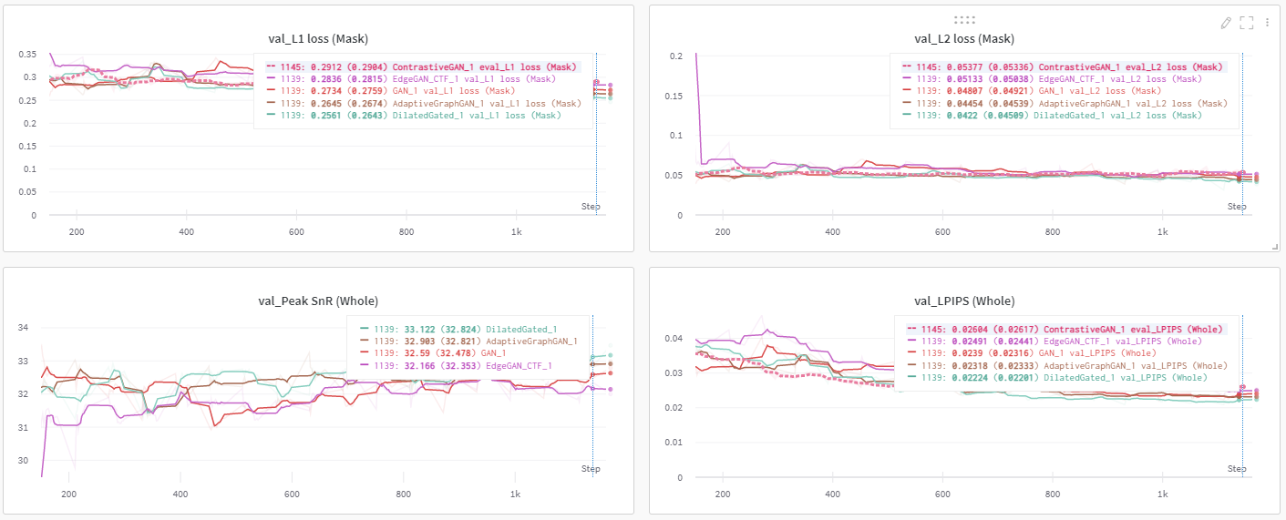
Results: Quantitatively

Slide 140
Insights #6: contrastive learning
Model poorer than baseline GAN qualitatively and quantitatively

Slide 141
Insights #6: contrastive learning
Model poorer than baseline GAN qualitatively and quantitatively
> Likely due to wrong underlying assumption of similarity

Slide 142
Insights #6: contrastive learning
Model poorer than baseline GAN qualitatively and quantitatively
> Likely due to wrong underlying assumption of similarity
output of images with different mask but same image is fundamentally different due to mapping at the level of sets

Slide 143
Insights #6: contrastive learning
Model poorer than baseline GAN qualitatively and quantitatively
> Likely due to wrong underlying assumption of similarity
output of images with different mask but same image is fundamentally different due to mapping at the level of sets
Ill-posed inpainting – different mask can map to different images

Slide 144
Insights #6: contrastive learning
Model poorer than baseline GAN qualitatively and quantitatively
> Likely due to wrong underlying assumption of similarity
output of images with different mask but same image is fundamentally different due to mapping at the level of sets
Ill-posed inpainting – different mask can map to different images
Contrastive loss then creates noisy optimization landscape

Slide 145
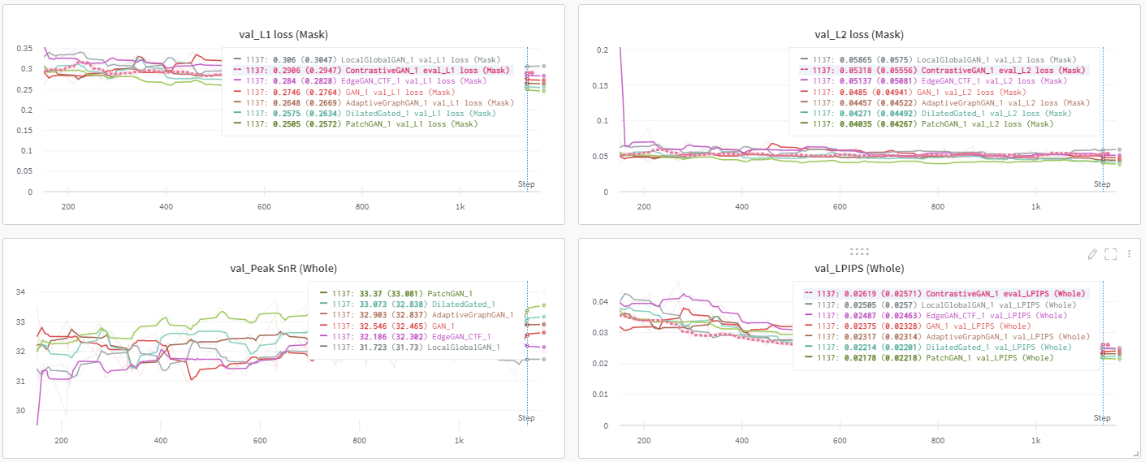
Final comparison of results

Slide 146
Final comparison of results
 | GAN | DilatedConvGAN | LocalGlobalGAN | PatchGAN | EdgeGAN | GraphGAN | ConstrastiveGAN
L1 loss | 0.2734 | 0.2720 | 0.3406 | 0.2517 | 0.2882 | 0.2766* | 0.2799
L2 loss | 0.04807 | 0.04458 | 0.07278 | 0.0389252 | 0.04940 | 0.04613* | 0.04635
LPIPS | 0.02316 | 0.01694 | 0.02063 | 0.01651 | 0.01878 | 0.01840* | 0.02058
PSnR | 32.59 | 34.44 | 32.32 | 35.03 | 33.98 | 34.33* | 34.25
First, second, third*

Slide 147
4. Conclusions
A review

Slide 148
Some insights we gleaned
Architectural insights
GAN-based models perform best, though training can be unstable
Patch-based discrimination provides powerful adversarial feedback
Dilated and Gated convolutions make significant differences
Graph-based message passing generator works well, but likely needs longer training time
Future work
Ablation studies with combinations of modules
Training bigger models for longer, and larger dataset
Better visualization of kernels via deconvolution, GRAD-CAM-like, etc.

Slide 149
Distribution of credit
All team members contributed equally. Presentation of slides was only cut this way for better flow of the content.

Slide 150
Citations
Elharrouss, O., Almaadeed, N., Al-Maadeed, S., & Akbari, Y. (2019). Image inpainting: A review.
Misra, Diganta. (2019). Mish: A Self Regularized Non-Monotonic Neural Activation Function.
He, Kaiming et al. “Deep Residual Learning for Image Recognition.” 2016 IEEE Conference on Computer Vision and Pattern Recognition (CVPR) (2016): 770-778.
Zhao, H., Gallo, O., Frosio, I., and Kautz, J., (2015). “Loss Functions for Neural Networks for Image Processing”
Farnia, F. and Ozdaglar, A., (2020) “GANs May Have No Nash Equilibria”
Durall, R., Chatzimichailidis, A., Labus, P., and Keuper, J., (2020) “Combating Mode Collapse in GAN training: An Empirical Analysis using Hessian Eigenvalues”
Iizuka, S., Simo-Serra, E., & Ishikawa, H. (2017). Globally and locally consistent image completion. ACM Transactions on Graphics, 36(4). https://doi.org/10.1145/3072959.3073659
Yu, J., Lin, Z., Yang, J., Shen, X., Lu, X., & Huang, T. (2018). Free-Form Image Inpainting with Gated Convolution. http://arxiv.org/abs/1806.03589
Liu, G., Reda, F. A., Shih, K. J., Wang, T.-C., Tao, A., & Catanzaro, B. (2018). Image Inpainting for Irregular Holes Using Partial Convolutions. http://arxiv.org/abs/1804.07723
Demir, U., & Unal, G. (2018). Patch-Based Image Inpainting with Generative Adversarial Networks. http://arxiv.org/abs/1803.07422
Isola, P., Zhu, J.-Y., Zhou, T., and Efros, A. A., “Image-to-Image Translation with Conditional Adversarial Networks”, 2016.
Wang, Y., Tao, X., Qi, X., Shen, X., & Jia, J. (2018). Image Inpainting via Generative Multi-column Convolutional Neural Networks. http://arxiv.org/abs/1810.08771
Crawshaw, M., “Multi-Task Learning with Deep Neural Networks: A Survey”, 2020.
Mou, C., Zhang, J., & Wu, Z. (2021). Dynamic Attentive Graph Learning for Image Restoration. http://arxiv.org/abs/2109.06620
Keyulu Xu, Weihua Hu, Jure Leskovec, Stefanie Jegelka, How Powerful are Graph Neural Networks? ICLR 2019
Ma, X., Zhou, X., Huang, H., Chai, Z., Wei, X., & He, R. (2020). Free-Form Image Inpainting via Contrastive Attention Network. http://arxiv.org/abs/2010.15643

